Slide 1
Project-2 (RESTAURANT)
Report by :
NAME : | REGISTRATION NO : | ROLL NO : | SECTION :
Shaik Khasim Basha | 12221508 | B-38 | KOC30
Sara Rewanth | 12217859 | B-59 | KOC30

Slide 2
Description of work by each member:
This project is made possible by Shaik Khasim Basha, Sara Rewanth . Every contribution is important to this project.
Shaik Khasim Basha: Code for the main page and the creating of logo. Design for the whole page.
And code for Home , Gallery page.
Sara Rewanth : Code for the images and the contact us information.

Slide 3
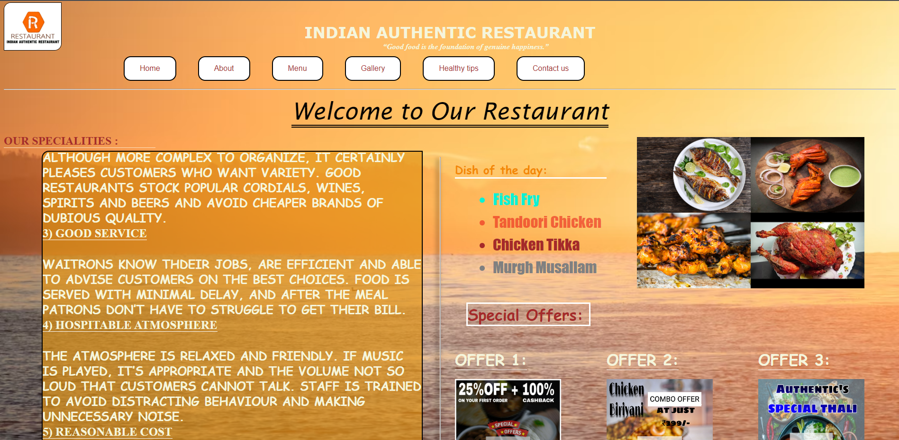
It is the Home page of our website.
Tags Used are: html,head,title,link,style,body,div,br,h1,h2,ol,
li,a,img,button,centre,span,class,CSS

Slide 4


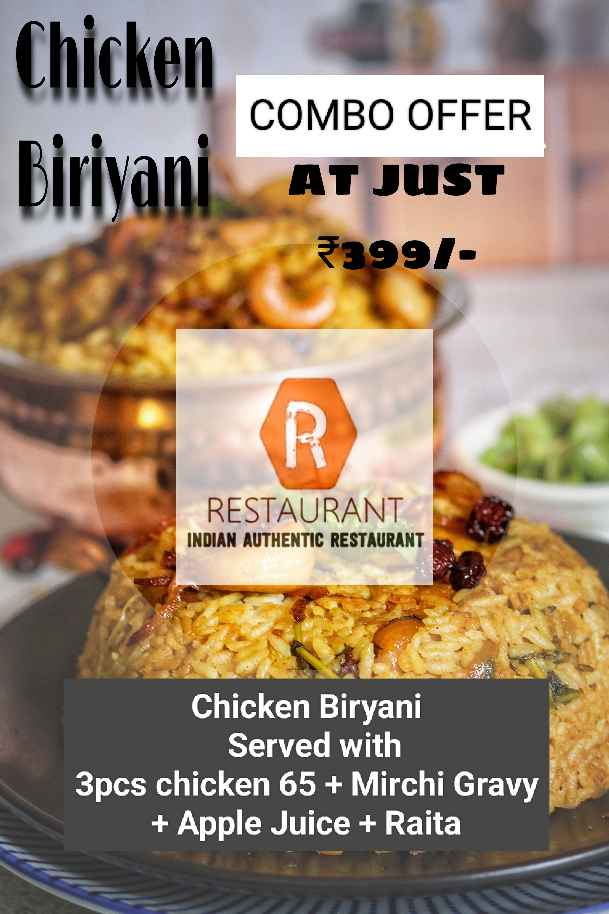

These are the images used in our website including our logo:

Slide 5
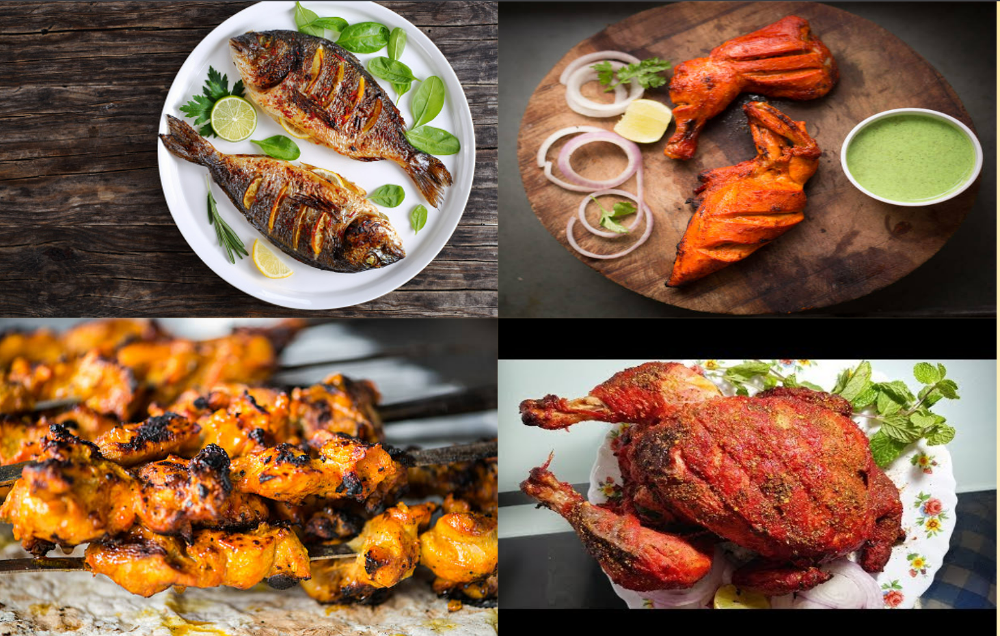
The special dishes given in the website are:

Slide 6
Details :
The Remaining images are taken from the Google images. And there are 6 buttons in the top
They Are: Home, About, Menu, Gallery, Healthy Tips, Contact us
These are the main buttons which helps us to go into detail about our RESTAURANT website.
At last we have given an Option to give Feedback to our RESTAURANT.
And the Offers of our RESTAURANT was given in the form of Images keeping SPECIAL OFFERS as the main heading for the offers.
On a Whole we have used EXTERNAL CSS for preparing this project.
NOTE : The website was made in the scale of 125% fontsize.

Slide 7
Thank You

